Slide 1
AgBioResearch
Office of Research Support
Doug Buhler – Director
George Smith – Associate Director
Mary Weinzweig – Finance & Business Manager
Carolyn Adams, Lori Bramble, Bill Humphrey
Research Coordinators

Slide 2
Commonly Used Proposal Acronyms
FOA = Funding Opportunity Announcement
RFP = Request For Proposals
RFA = Research For Applications
All of these refer to the solicitation/proposal from the agency or sponsor.
SPA = Sponsored Programs Administration (Unit name for OSP and CGA)
OSP= Office of Sponsored Programs (Pre-award)
CGA = Contract and Grant Administration (Post-award)
F&A = Facilities and Administrative Cost Rate
IDC = Indirect Cost Rate
NICRA= Negotiated Indirect Cost Rate Agreement
All of these refer to the federally negotiated rate. The F&A rate is negotiated with the Department of Health & Human Services (DHHS)
TDC (Total Direct Costs)
Refers to the direct costs of the project budget.
MTDC (Modified Total Direct Costs)
Refers to the final total of a budget when any exempt items (equipment, capital expenditures, patient care, rental costs, tuition & fees, scholarships, fellowships, participant support costs and subawards in excess of $25,000 have been removed from the bottom line.

Slide 3
Read Your Solicitation!
The solicitation will provide you with specific and important information:
FOA number and title
How to submit the final package (e-mail, Grants.gov, FastLane, etc.)
Due dates
Letter of intent (if applicable)
Proposal
Budget & Justification information
F&A limits
Award project period (years)
Yearly or total project dollar limits
Budget category limits (student stipends, salary, supplies, etc.)
Cost share
Formatting
Page limitations
Margins
Font
Typeface
Headers and footers
Naming of documents
Order of documents
Proposal content (objectives, plans, methods, implementation, etc.)
Review and selection process for your proposal
Award administration and conditions
Reporting requirements
**The solicitation takes precedence over the agency guidebook (if applicable)

Slide 4
MSU Extension Contacts
Agriculture and Agribusiness:
Institute Director: Ronald Bates 432-7693 batesr@msu.edu
Fiscal Officer: Keri Morris 355-4623 morrisk@msu.edu
Children and Youth:
Institute Director: Julie Chapin 432-7608 chapin@msu.edu
Fiscal Officer: Holly Lacina 432-6567 lacinah@msu.edu
Greening Michigan:
Institute Director: Dave Ivan 432-4602 ivand@msu.edu
Fiscal Officer: Keri Morris 355-4623 morrisk@msu.edu
Health and Nutrition:
Institute Director: Dawn Contreras 353-3886 contrer7@msu.edu
Fiscal Officer: Nick Bourland 432-7687 bourlan@anr.msu.edu

Slide 5
Office of Sponsored Programs (OSP)
CANR, AgBioResearch, MSU Extension
ProposalTeam2@osp.msu.edu
Proposal Team 2 Manager: Craig O’Neill

Slide 6
OSP Proposal Deadline Policy
OSP has a “10:6:3” proposal submission deadline policy:
10 days prior to the deadline the solicitation (if available) should be provided to OSP.
At least 6 days in advance the final budget and budget justification should be sent to OSP for review. eTransmittals should be routed at 6 days, even if the budget isn’t approved (make notes on transmittal).
The complete proposal needs to be sent to OSP 3 full business days before submission deadline.
A proposal is considered late when OSP receives the final package with less than 3 full business days prior to the submission deadline.
A proposal is considered at-risk when it is provided to OSP within 8 business hours of the submission deadline.
At-risk proposals must be specifically endorsed by the department chair/director and the Associate Dean for Research (Dr. Doug Buhler)
On time proposals will take priority over late and at-risk proposals

Slide 7
MSU Extension Agreement
Handout Provided
To be completed between you and your Fiscal Officer before starting proposal
3 – 2 – 1 Timeline

Slide 8
Timeline for Proposal Development
3+ Weeks before deadline:
Initiate contact with Fiscal Officer (FO)
Provide copy of funding agency’s request for proposals.
Complete Time-Line Agreement with FO
Contact sub-awardees
Arrange REQUIRED match with Institute Director
2+ Weeks before deadline:
Budget finalized and routed to MSU OSP
Obtain final commitments from sub-awardees
Documentation of REQUIRED match
1+ Week before deadline:
Route final transmittal
Package proposal

Slide 9
MSU Extension Principal Investigator Eligibility
MSU Principal Investigator (PI) eligibility traditionally requires a Ph.D. and tenure stream appointment at MSU.
MSUE has an exemption for Extension Educators with Masters degrees or prior approval to serve as PIs.
OSP is not always aware of this exemption.
Supervising Educators often serve as Principal Investigator for Extension Program Coordinators, Instructors, and Associates.

Slide 10
Funding Sources
Office of Vice President for Research and Graduate Studies
https://vprgs.msu.edu/find-funding
Council of Michigan Foundations
https://www.michiganfoundations.org/grantseekers
The Funding Center
http://staff.lib.msu.edu/harris23/grants/0fdncoll.htm

Slide 11
Funding Continued
MSU Extension projects often fall under “Public Service” rather than “Research.”
Opportunities for collaboration with research in Agriculture & Natural Resources; Social Science; Natural Science; Business; Human Medicine; Osteopathic Medicine; Nursing; Veterinary Medicines; Engineering (Civil)
Stakeholder/Community Impact
Research Participants – Human/Animal
IRB Required
Information Dissemination
Consultation

Slide 12
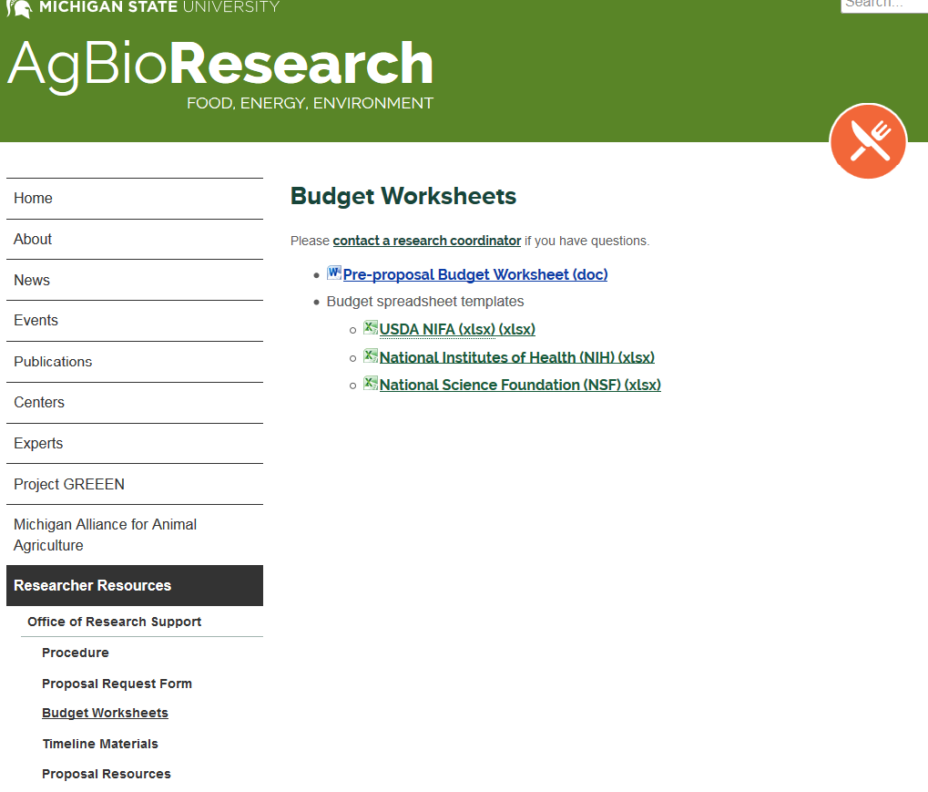
Elements of Proposal Budget
Budgets: Excel templates are the easiest to use
• They have formulas and automatic calculations built in
All templates have 5 year budgets
Do not delete the years you don’t need, minimize them!
NIH & NSF templates are the same except for title at the top
USDA has 2 F&A rates listed at the bottom for comparison
AgBioResearch.msu.edu/Researcher Resources/Office of Research Support/Budget Worksheets

Slide 13
Elements of Proposal Budget (cont.)
Salaries and Wages – calculated in person months and/or percent of effort
Faculty: AN, AY and Summer
Extension Educators
Postdoctoral Research Associates
Graduate Students
Undergraduate Students/Hourly Labor
*Administrative and Clerical Staff, as justified
Fringe Benefits
SI Fringe
Graduate Student
Hourly workers
Affordable Care Act
OSP/CGA Salary Budget Builder
Get current salaries for MSU faculty and staff
Use your project start date
Export and save salary figures to your excel budget template

Slide 14
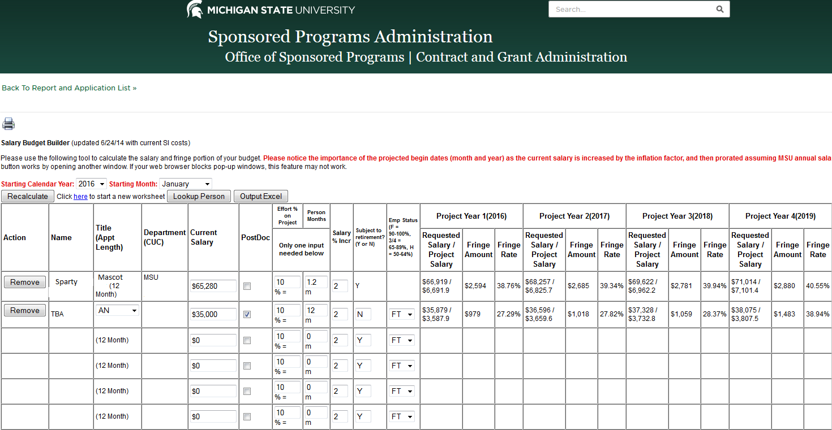
Salary Budget Builder

Slide 15
Elements of Proposal Budget (cont.)
Equipment – item with a purchase price of more than $5,000 and an expected service life of more than one year
Travel – Domestic and International
Participant Support Costs
Stipend
Travel
Subsistence
Other
Other Direct Cost
Materials and Supplies
Publications
Consultant Services
Subcontracts (F&A is charged on the first $25,000 only)
Other (Tuition and Fees)

Slide 16
Elements of Proposal Budget (cont.)
Cost Share/Match
Mandatory Cost Share – required by the sponsor as a condition of receiving the award, usually included in the proposal.
Voluntary Committed Cost Share – not required by the sponsor as a condition of receiving an award. Included in the proposal to be contributed by the University and it becomes a binding commitment to the University upon award.
Cost sharing should only be included in a proposed budget, narrative or budget justification when required by the solicitation.
Cost share MUST be approved by the unit contributing. Please plan accordingly in order to get proper approvals in advance.

Slide 17
Elements of Proposal Budget (cont.)
F&A/Indirect Cost/Overhead
Supports University Infrastructure: departmental administration, operations, building maintenance, heating, lighting, custodial services, campus security, phones, etc.
Some items exempt from F&A are:
Equipment
Participant support costs (fellowships, scholarships)
Subawards in excess of the first $25,000
Graduate tuition and fees
Current Rates Future Rates
(through 6/30/2016) (7/1/2016 – 6/30/2019)
Research 53.5%* 55%
Other Sponsored Activities 36% 36%
Off-Campus 26% 26%
Testing 26% 26%
State of Michigan 20% 20%
*Use this rate for year 1 of any proposals with a start date before 7/1/2016!
Reduced F&A rates must be justified
documented in proposal solicitation
waivers must be requested from VPRGS (Vice President for Research and Graduate Studies)

Slide 18
Excel Budget Example

Slide 19
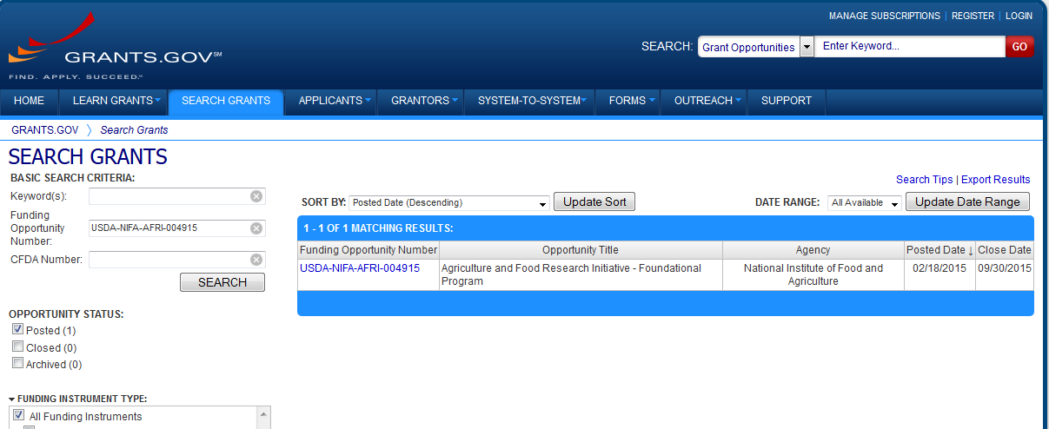
Grants.Gov

Slide 20
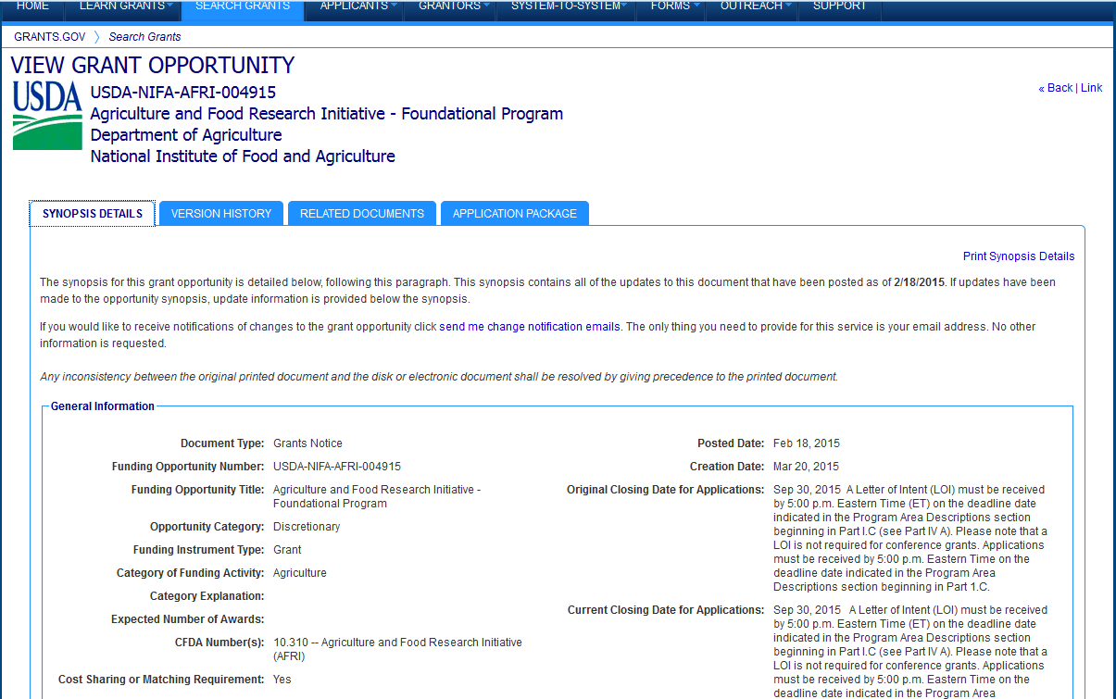
Details of Grant Opportunity

Slide 21
Download Package and Instructions

Slide 22
Download Package and Instructions

Slide 23
Download Package and Instructions

Slide 24
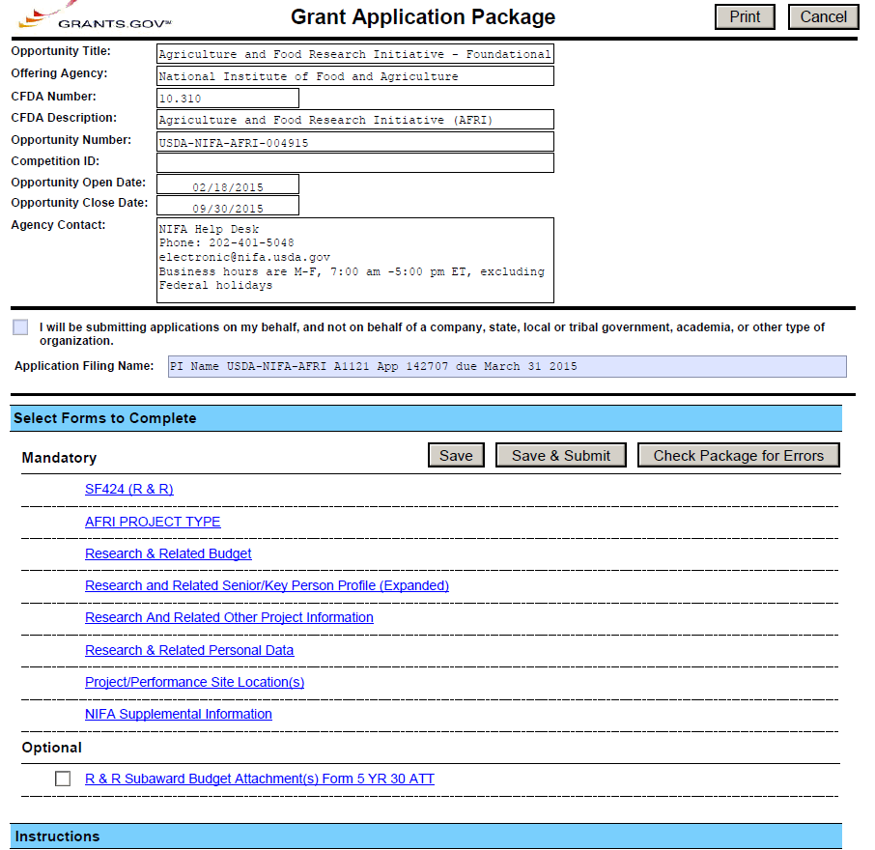
Grants.gov Package (SF 424 R&R)

Slide 25
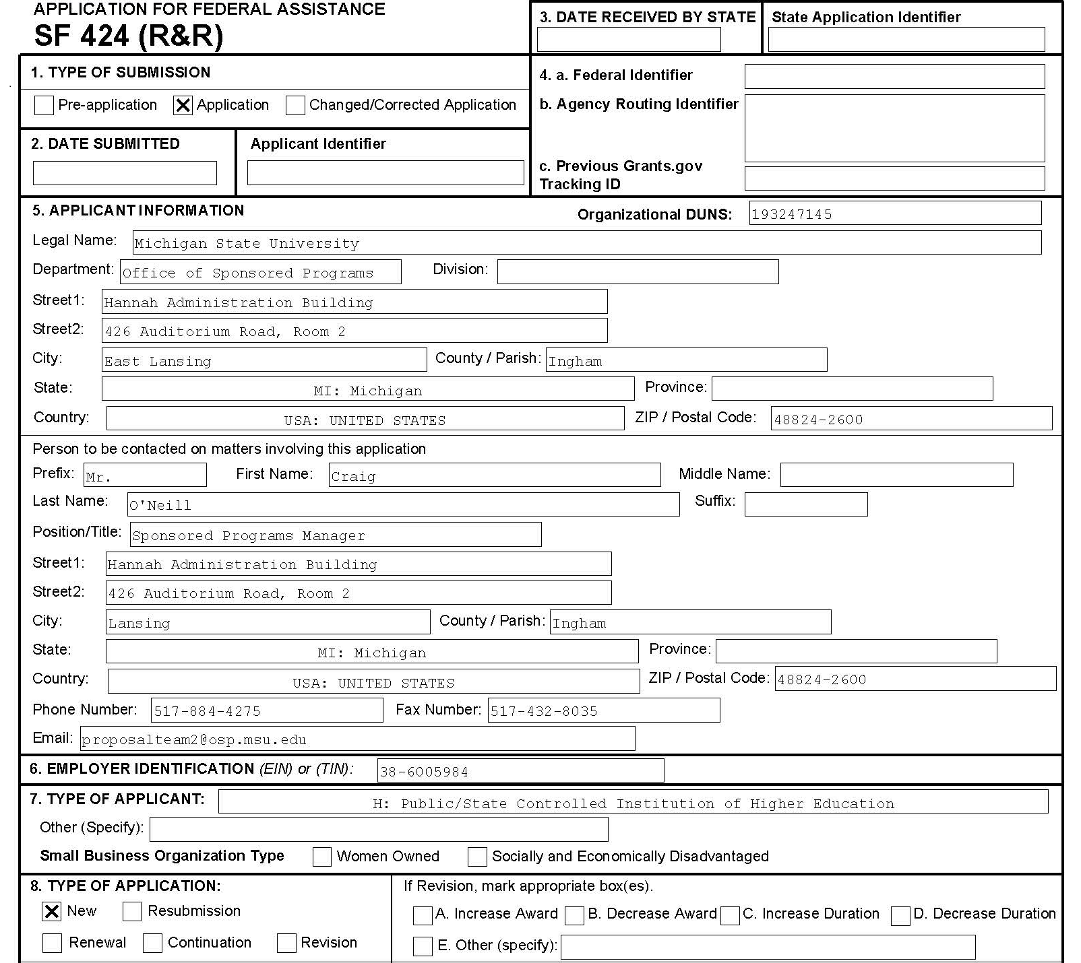
Grants.gov Package (SF 424 R&R)

Slide 26
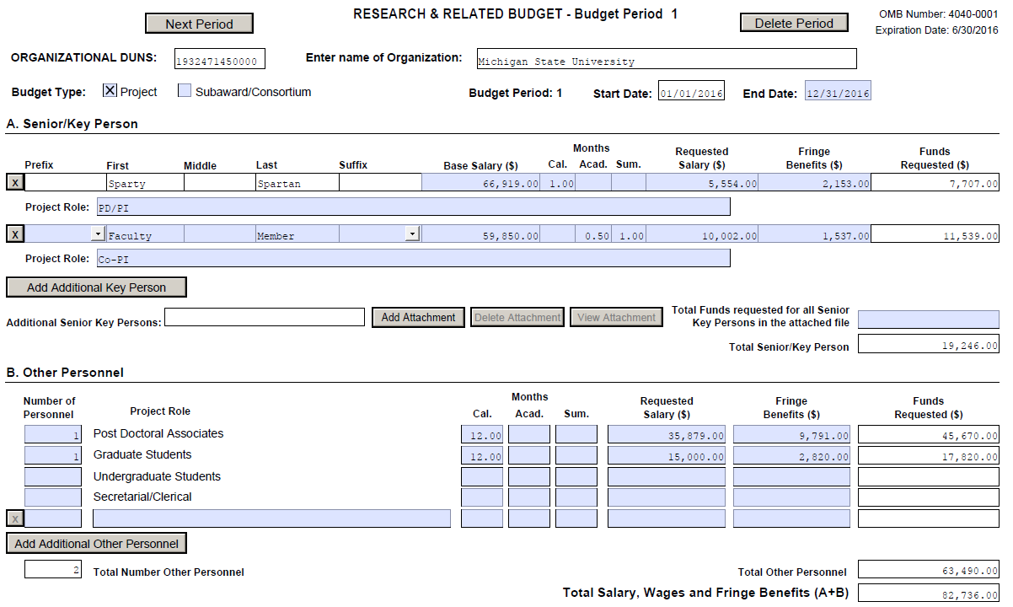
Grants.gov Package (SF 424 R&R)

Slide 27
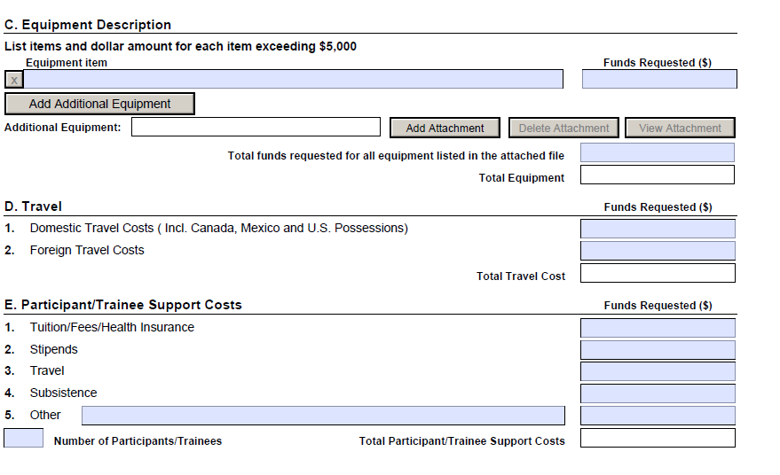
Grants.gov Package (SF 424 R&R)

Slide 28
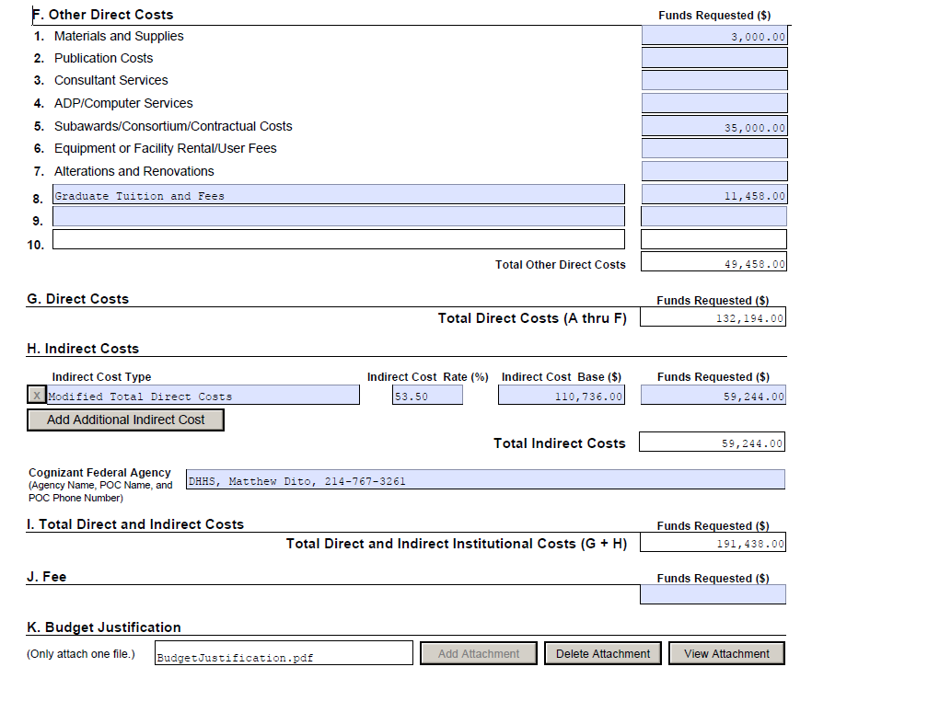
Grants.gov Package (SF 424 R&R)

Slide 29
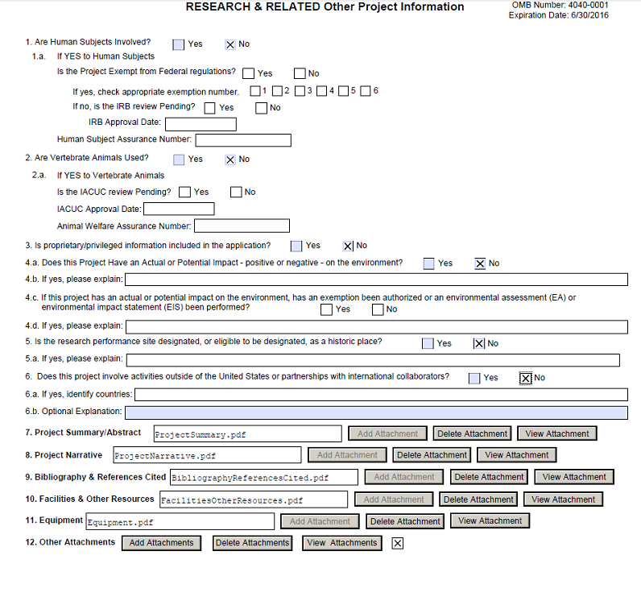
Grants.gov Package (SF 424 R&R)

Slide 30
MSU eTransmittal
Internal routing form for tracking proposal submissions
Tracks the number and dollar amount of grants submitted
Used to track faculty, department and college research activity
Reappointment, Promotion and Tenure Review
*Must be completed and fully approved up to OSP approval level PRIOR to grant submission
Required attachments to submit:
Abstract/Project Summary
OSP Approved Budget
Budget Justification
Request for Proposal/Solicitation (if available)
Recommended attachments (if applicable):
Cost Share Budget
Sub-recipient Budget, Justification, Statement of Work, and Commitment Form
MSU Commitment Form
F&A Waiver
Principal Investigator Waiver

Slide 31
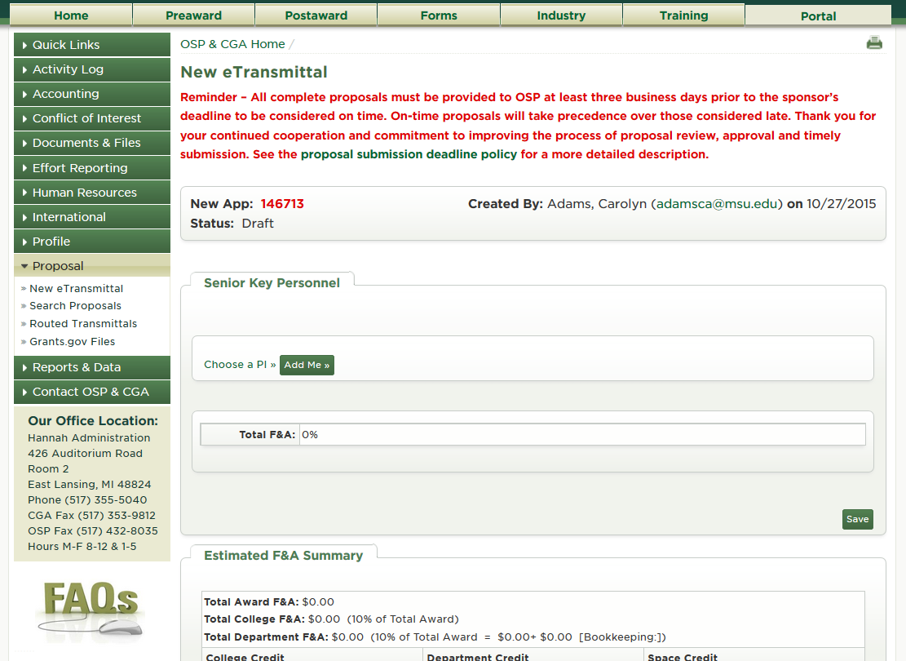
Log into osp.msu.edu
Select “Proposal –> New eTransmittal from the green menu on the left

Slide 32
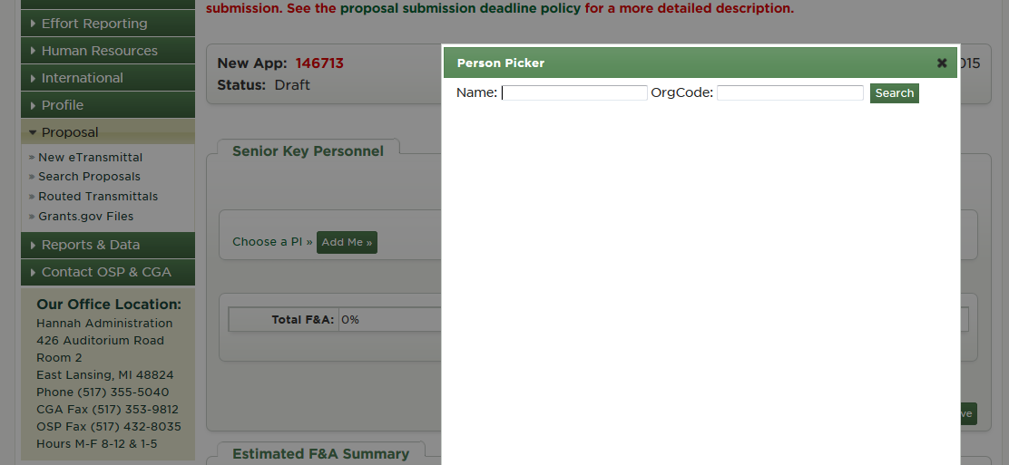
Click “Choose a PI” - Person Picker will pop-up
Type “last name, first name”
Highlight persons name and enter (repeat this step for all Senior Key Personnel)
Always list the lead PI first when there are multiple PI’s

Slide 33
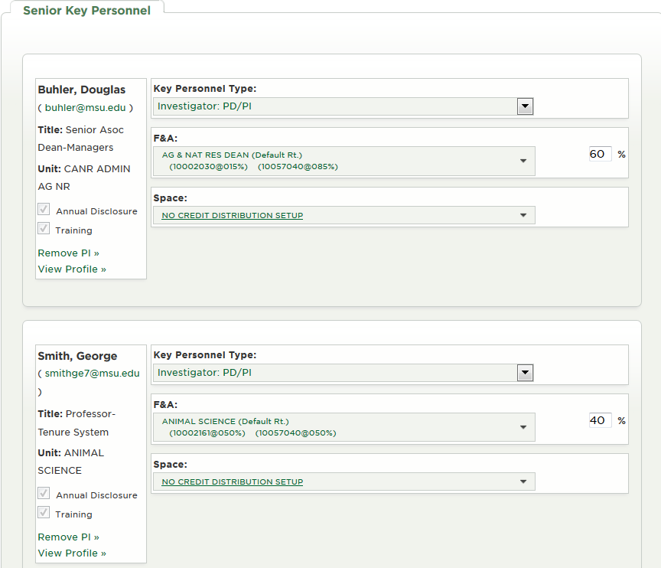
Choose the Key Personnel Type for each person using the drop down arrow
Ensure the F&A distribution includes either their base or default profile
F&A Distribution percentage among senior key personnel must total 100%

Slide 34
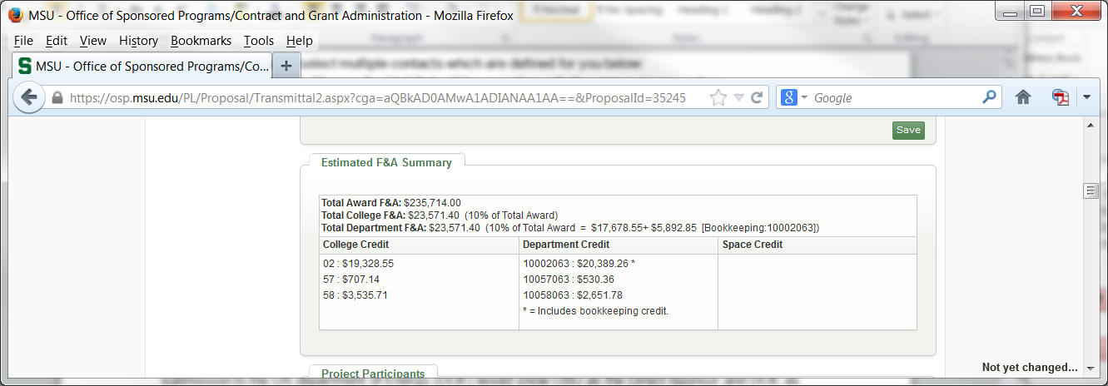
College and Departmental F&A split is automatically calculated

Slide 35
Project Participants section is required for any PHS or NSF proposals. All project participants must be added as well as their role on the project.

Slide 36
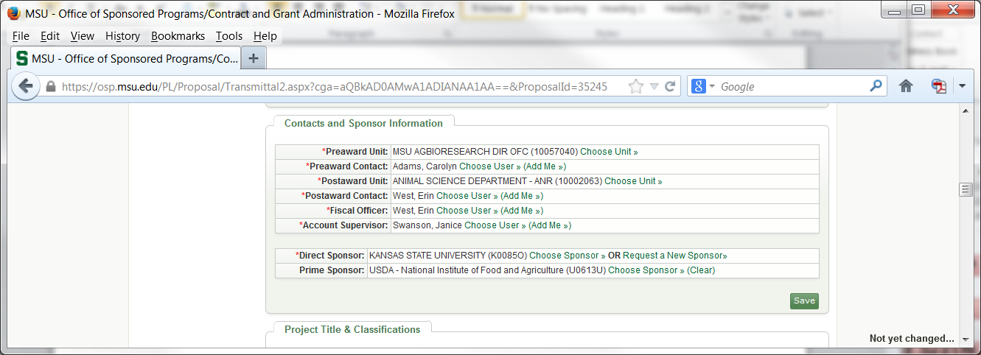
Pre-award Unit: Unit assisting with proposal submission.
Pre-award Contact: Contact person assisting with proposal submission.
Post-award Unit: Unit responsible for post-award administration.
Post-award Contact: Contact person providing post-award administration.
Fiscal Officer: Person with responsibility for accounting transactions to the grant account.
Account Supervisor: Normally Director/Chair of the Unit or another individual with oversight.
Direct Sponsor – Entity giving us funds
Prime Sponsor – Entity sponsoring the research

Slide 37
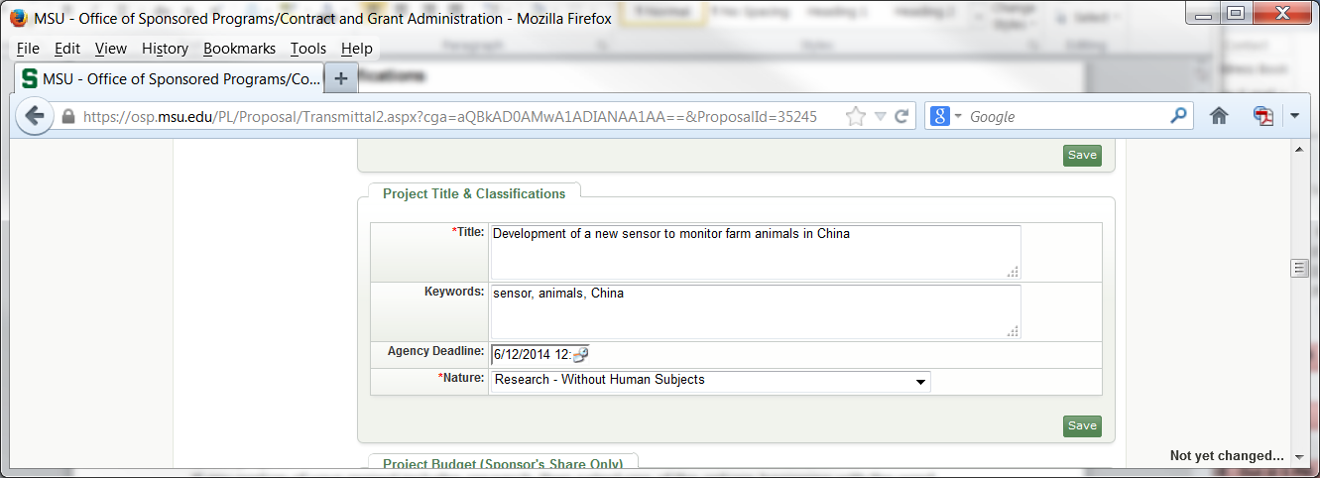
Add Project Title, Project Keywords, Agency Deadline, nature/type of project.
If the project involves international activities, list the country/countries in Keywords.
If the nature of the project includes research, select one of the options beginning with “Research”. Extension is generally “Public Service or Education”

Slide 38
List the first year budget and the total project budget.
Break out direct cost from the facilities and administrative amount.

Slide 39
Include the total amount of subcontracts, total amount of cost share and F&A rate.
Cost Share–ONLY list total amount of mandatory cost share specified in the solicitation.
Voluntary Cost Share should only be listed in the notes section.

Slide 40
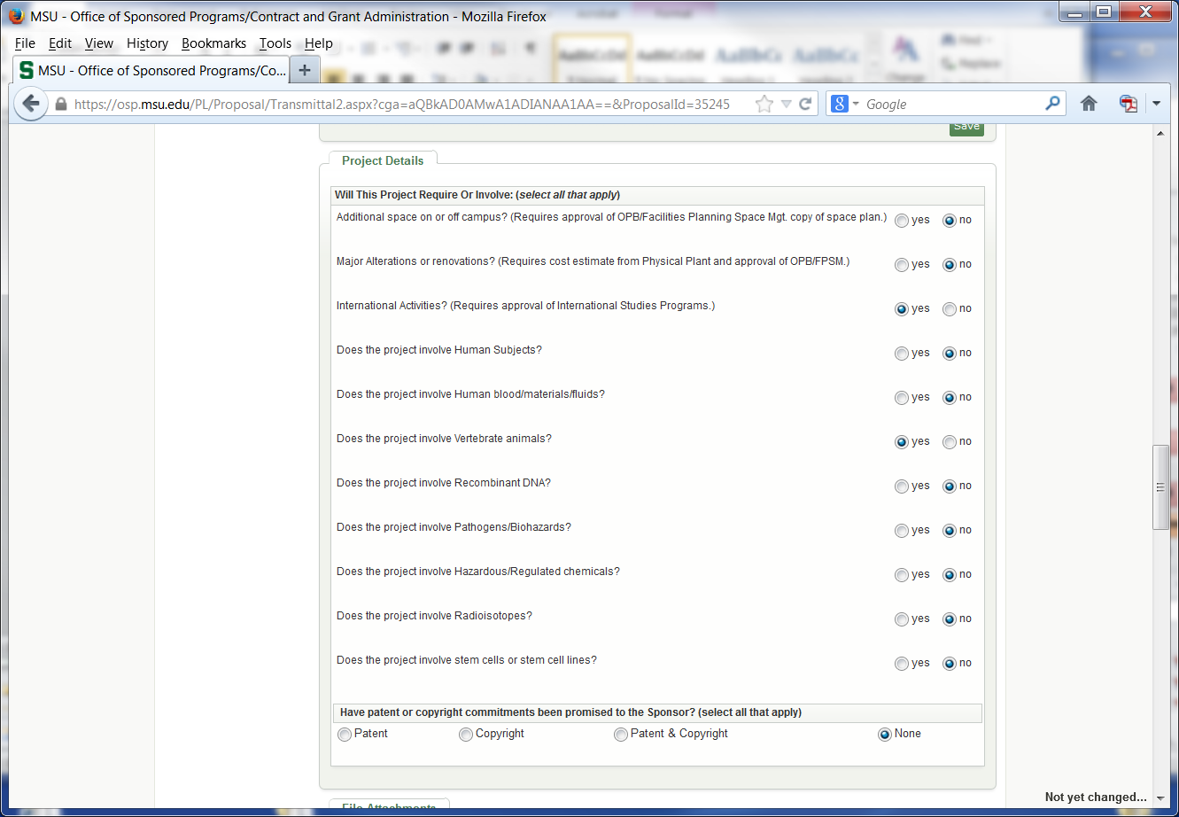

Slide 41
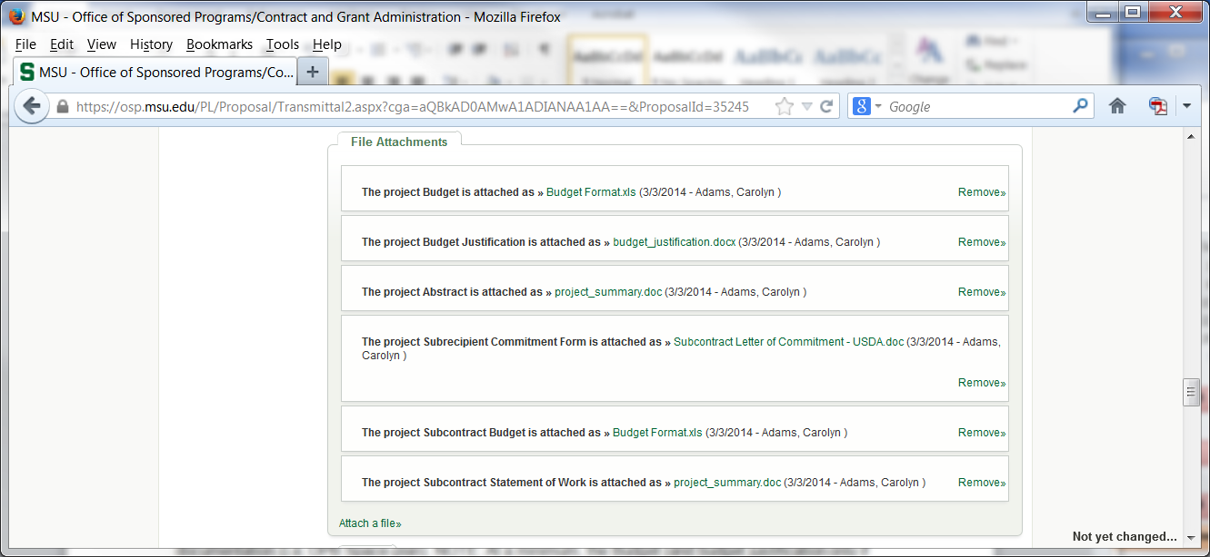
Required document attachments - budget, budget justification, project summary and solicitation are needed (can be word, excel or pdf format)
If project includes subcontracts, must also include subcontract budget, subcontract budget justification, subcontractor statement of work, and sub-recipient commitment form.

Slide 42
Include notes on:
Voluntary Committed Cost Share
Who, from OSP, approved the budget and date it was approved
F&A rate, when different than the standard negotiated rate
Anything a reviewer may need to know to approve the transmittal

Slide 43
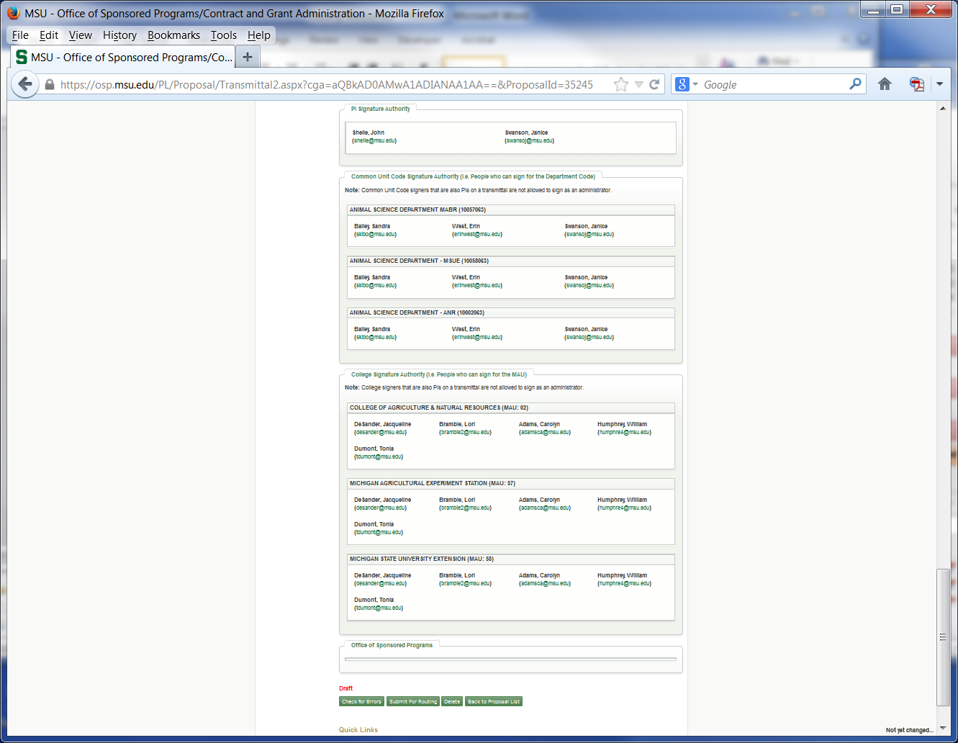

Slide 44
eTransmittal-Things to keep in mind
Allow enough time for transmittal review and approval.
Track status of transmittal approvals. Send reminders if needed.
An eTransmittal is NOT needed for a pre-proposal or letter of intent unless:
Required cost share commitments
Sponsor requires an authorized organizational representative review of the budget
Intellectual property ownership or export control issues
PI Exception Approval is requested with the Department Chair/Director, then sent to AgBioResearch before going to VPRGS for final approval.
IDC waivers and reductions are to be submitted to AgBioResearch at least 7 days before the proposal deadline; must be approved prior to grant start date.
Only required cost share is entered in the cost share field. Voluntary cost share is included as a note.
Budget, Budget Justification, Scope of Work and Solicitation should be included as attachments.
Delete eTransmittals that you start, and don’t route.

Slide 45
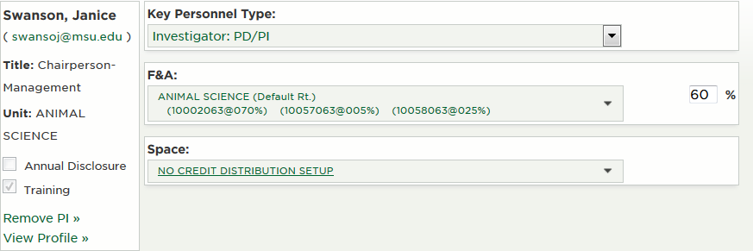
Conflict of Interest
All MSU faculty, academic staff and other individuals who propose, conduct or report the results of University research and other sponsored projects must submit an annual disclosure of all significant financial interests related to their MSU responsibilities
Conflict of Interest Training - updated every 4 years
Annual Disclosure - updated January 1st every year or within 30 days of acquiring a new significant financial interest (SFI).

Slide 46
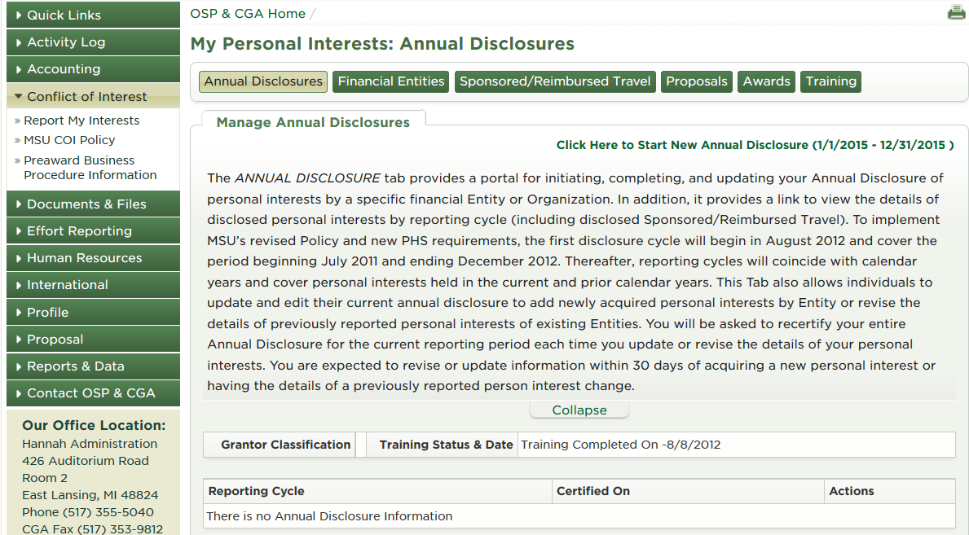
Conflict of Interest
Conflict of Interest (cont.)

Slide 47
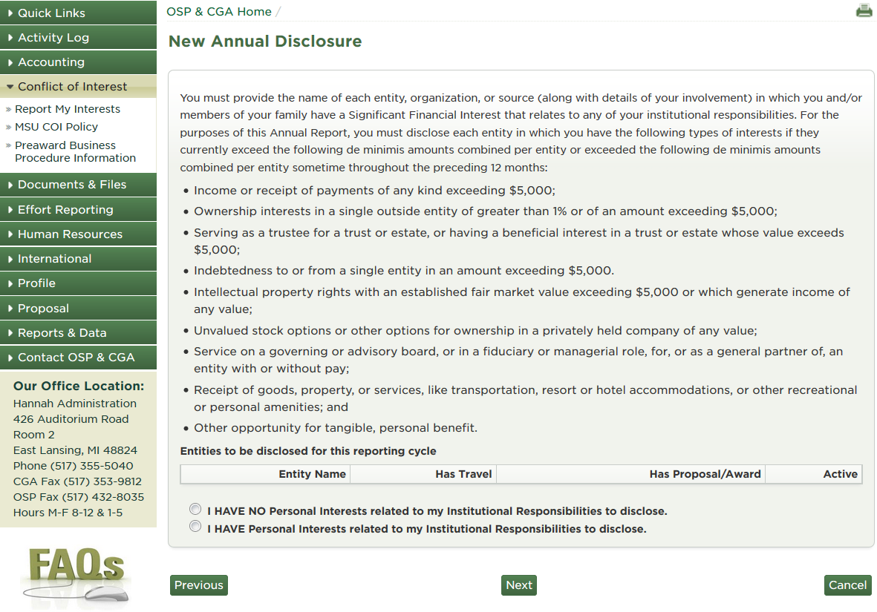
Conflict of Interest (cont.)

Slide 48
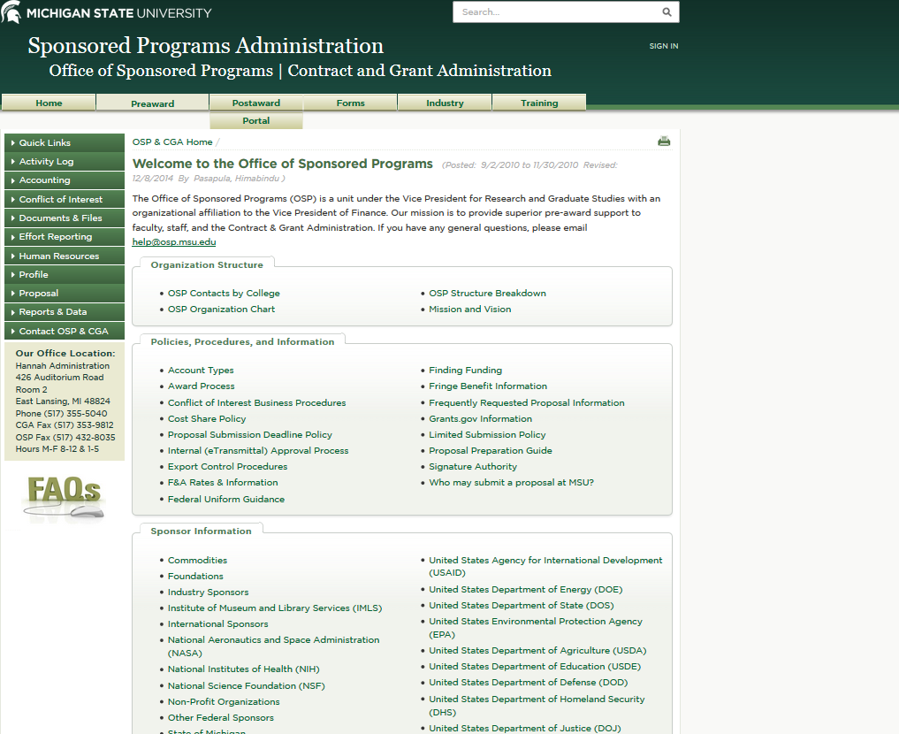

Slide 49
Regulatory Affairs
The Office of Regulatory Affairs (ORA) assists the MSU community in understanding and complying with the laws, regulations and standards for research and teaching.
Office of Regulatory Affairs Units:
Human Research Protection Program
Animals In Research
Institutional Stem Cell Research
Environmental Health and Safety

Slide 50
Human Research Protection Program
All individuals involved in a human subject research project who have contact with human subjects or their identifiable data must have current human research protection training, initial training is valid for two years. Renewal involves completing any six CITI courses.
All research involving human subjects must be reviewed and approved by an Institutional Review Board (IRB) before the study begins.
MSU has three Institutional Review Boards (IRBs):
Social Science, Behavioral, Education Institutional Review Board (SIRB)
Biomedical and Health Institutional Review Board (BIRB)
Community Research Institutional Review Board (CRIRB)
Initial Application Time Frames
Exempt – 7-10 working days
Expedited – 3-5 weeks
Full Review – 6-8 weeks
Most IRB approvals expire one year from the date of approval.

Slide 51
Things to Remember!
PLAN AHEAD!!!
Review solicitation carefully
Follow formatting guidelines
Contact internal reviewers
Ask for help

Slide 52
MSU Extension Contacts
Agriculture and Agribusiness:
Institute Director: Ronald Bates 432-7693 batesr@msu.edu
Fiscal Officer: Keri Morris 355-4623 morrisk@msu.edu
Children and Youth:
Institute Director: Julie Chapin 432-7608 chapin@msu.edu
Fiscal Officer: Holly Lacina 432-6567 lacinah@msu.edu
Greening Michigan:
Institute Director: Dave Ivan 432-4602 ivand@msu.edu
Fiscal Officer: Keri Morris 355-4623 morrisk@msu.edu
Health and Nutrition:
Institute Director: Dawn Contreras 353-3886 contrer7@msu.edu
Fiscal Officer: Nick Bourland 432-7687 bourlan@anr.msu.edu
Thank You
Sponsored by AgBioResearch Office of Research Support

